Slide 1
MATH-352 Numerical Methods
Atifa Kanwal
atifa.kanwal@seecs.edu.pk
Office # 303, Faculty Block, SEECS, NUST

Slide 2
Introduction and Error Analysis
Numerical Methods by Chapra
Numerical Analysis by Burden & Faires

Slide 3
Introduction
Numerical Methods are techniques by which mathematical problems are formulated so that they can be solved with arithmetic operations.
Although numerical methods involve large numbers of tedious arithmetic calculations, however with the development of fast efficient digital computers, the role of numerical methods in engineering problem solving has increased dramatically in recent years.

Slide 4
Why should you study Numerical Methods
Numerical methods are capable of handling large systems of equations, nonlinearities and complicated geometries that are often impossible to solve analytically.
For Example
To solve the problems that can not be solved analytically

Slide 5

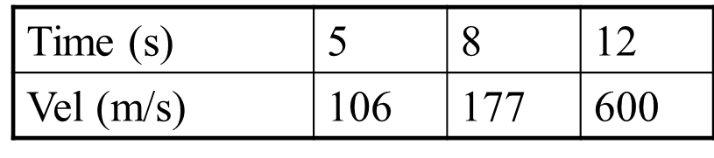
What is the acceleration at t=7 seconds?

Slide 6
You often use commercially available prepackaged computer programs that involve numerical methods. The intelligent use of these programs is often predicated on knowledge of the basic theory underlying these methods.
Many problems cannot be approached using canned programs. If you are conversant with numerical methods and are adept at computer programming, you can design your own programs to solve problems.

Slide 7
Errors
The knowledge we have of the physical world is obtained by doing experiments and measurements. In this course, we analyze such data and draw conclusions from it.
In doing this it is crucial to understand that all measurements of physical quantities are subject to uncertainties. It is never possible to measure anything exactly.
It is good to make error as small as possible but it is always there. And in order to draw valid conclusions, the error must be indicated and dealt properly.

Slide 8
Sources of Errors
The main sources of error are as follow:
Gross Error are either caused by human mistakes or by the computer.
Round-off Error is introduced by rounding-off numbers to a limited number of decimal places.
In order to obtain a smaller error as a result of rounding-off error, we apply the following rules when performing manual calculations.

Slide 9
Sources of Errors: Rules of Rounding off
If the first discarded digit is less than 5 the previous digit is unchanged.
If the first discarded digit is greater than 5 the previous digit is increased by 1.
If the first discarded digit is exactly 5 the previous digit is increased by 1 if it odd and is unchanged if it is even.
Example:
56.44 becomes 56.4
Example:
56.47 becomes 56.5
Examples:
56.45 becomes 56.4
56.75 becomes 56.8

Slide 10
Sources of Errors:Cont…
Truncation Error arises when we replace one infinite series by another with fewer terms. In analyzing errors arising from the truncation of series, several types of series expansions can be considered. These include the following.
Binomial expansion
Infinite geometric progression
Taylor or Maclaurin Series
In this course, we will consider only Taylor/Maclaurin series.

Slide 11
Precision and Accuracy
Accuracy refers to how closely a computed a measured value agrees with the true value.
Precision refers to how closely individual computed or measured value agrees with each other.
Precision is governed by the number of digits being carried in the numerical calculations.
Accuracy is governed by the errors in the numerical approximation.

Slide 12
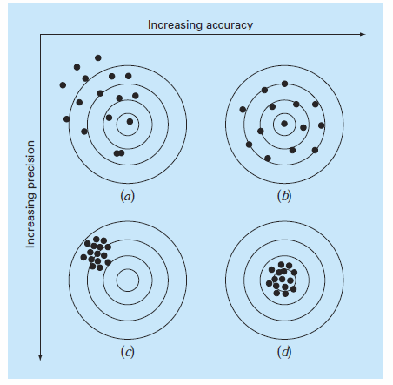
Example
Let us consider example of target practice.
Bull’s eye represents the truth value.
The bullet holes on each target in fig represent approximations of numerical technique.
Results in (b) and (d) are equally accurate but (d) is more precise.

Slide 13
Significant Digits/Figures

Slide 14
Significant Digits/Figures
The significant digits in a measurement consist of all the digits known with certainty plus one final digit, which is uncertain or is estimated.

Slide 15
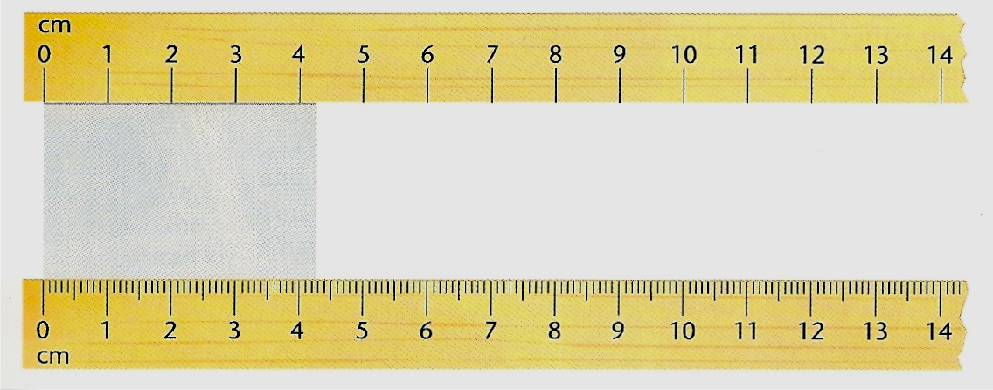
For example: Study the diagram below.
Using the ruler at the top of the diagram, what is the length of the darker rectangle found in between the two rulers?
Answer: The length is between 4 and 5 cm. The “4” is certain, but the distance past 4 cm will have to be estimated. A possible estimate might be 4.3. Both of these digits are significant. The first digit is certain and the second digit is uncertain because it is an estimate.

Slide 16
Using the ruler at the bottom of the diagram, what is the length of the darker rectangle found in between the two rulers?
Answer: The edge of the rectangle is between 4.2 cm and 4.3 cm. We are certain about the 4.2, but the next digit will have to be estimated. As possible estimation might be 4.27. All three digits would be significant. The first two digits are certain and the last digit is uncertain.

Slide 17
Please remember…
The last digit in a measurement is always the uncertain digit.
It is significant even if it is not certain.
The more significant digits a value has, the more accurate the measurement will be.

Slide 18
There are quite a few rules that determine how many significant digits a measurement has. You will need to memorize these rules.

Slide 19
RULE: If a number contains no zeros, all of the digits are significant.
How many significant digits are in each of the following examples?
a) 438
b) 26.42
c) 1.7
d) .653
Answers:
3
4
2
3

Slide 20
RULE: All zeros between two non zero digits are significant.
How many significant digits are in each of the following examples?
a) 506
b) 10,052
c) 900.431
Answers:
3
5
6

Slide 21
RULE: Zeros to the right of a non zero digit a) If they are to the right of a nonzero number but not sandwiched between nonzero and decimal point, they are not significant.
How many significant digits are in each of the following examples?
a) 4830
b) 60
c) 4,000
Answers:
3
1
1

Slide 22
RULE: Zeros to the right of a non zero digit b) If these zeros are sandwiched between a nonzero number and a decimal point, they are significant.
How many significant digits are in each of the following examples?
a) 4830.
b) 60.
c) 4,000.
Answers:
4
2
4

Slide 23
RULE: In decimals less than one, zeros to the right of a decimal point that are to the left of the first non-zero digit are never significant. They are simply place holders.
Answers:
1
2
1
How many significant digits are in each of the following examples?
a) 0.06
b) 0.0047
c) 0.005

Slide 24
RULE: All zeros to the right of a decimal point and to the right of a non-zero digit are significant.
How many significant digits are in each of the following examples?
a) .870
b) 8.0
c) 16.40
d) 35.000
e) 1.60
Answers:
3
2
4
5
3

Slide 25

Practice Problems
How many significant digits are in each of the following examples?
1) 47.1
2) 9700.
3) 0.005965000
4) 560
5) 0.0509
6) 701.905
7) 50.00
8) 50.012
9) 0.000009
10) 0.0000104
Answers:
3
4
7
2
3
6
4
5
1
3

Slide 26
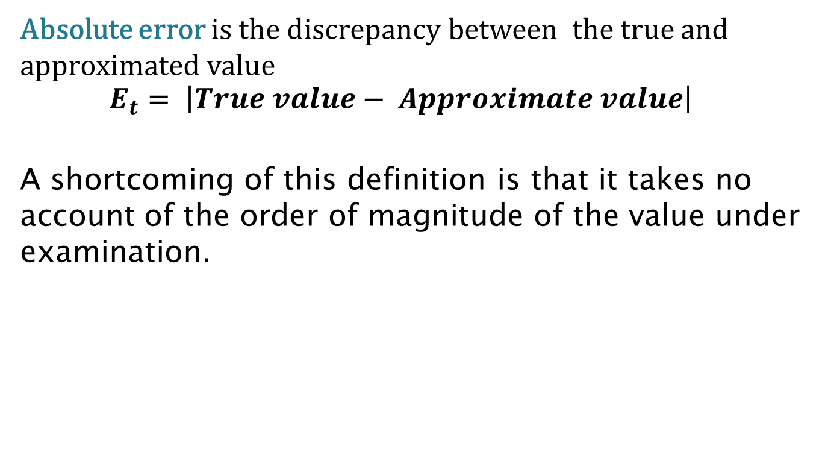
Error Definitions
Absolute error is the discrepancy between the true and approximated value
$$E_{t}= \left|True value− Approximate value\right|$$
A shortcoming of this definition is that it takes no account of the order of magnitude of the value under examination.

Slide 27
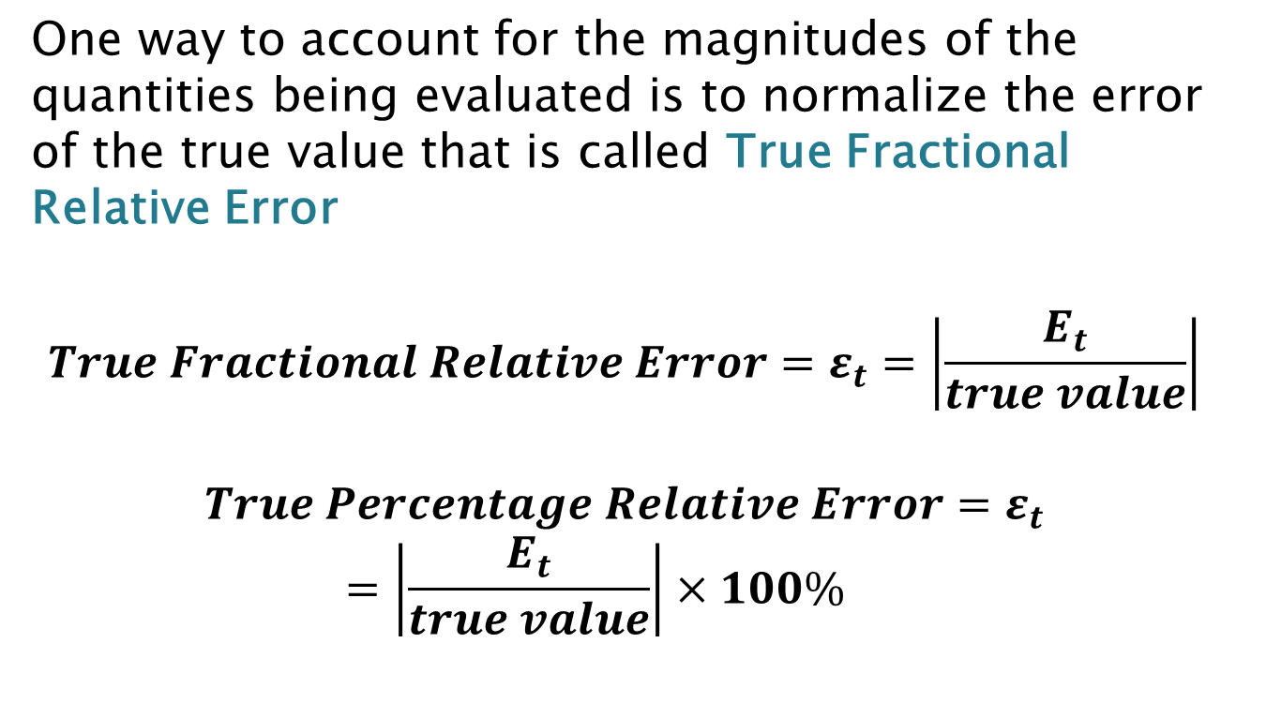
Error Definitions:Cont…
One way to account for the magnitudes of the quantities being evaluated is to normalize the error of the true value that is called True Fractional Relative Error
$$True Fractional Relative Error=ε_{t}=\left|\frac{E_{t}}{true value}\right|$$
$$True Percentage Relative Error=ε_{t}=\left|\frac{E_{t}}{true value}\right|×100\%$$

Slide 28
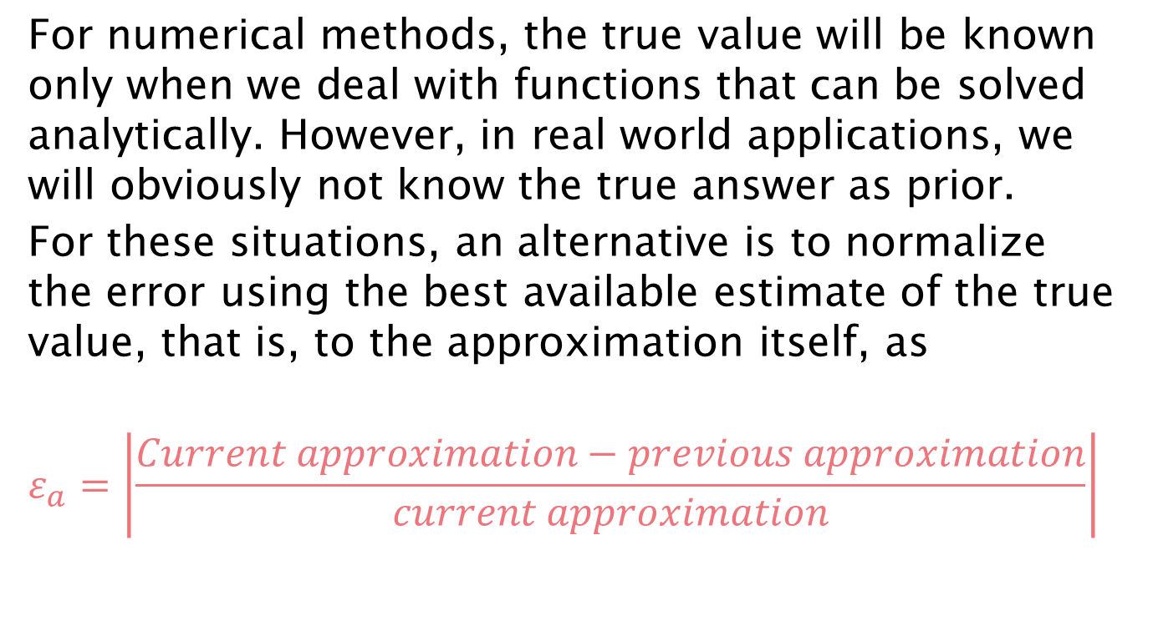
Error Definitions:Cont…
For numerical methods, the true value will be known only when we deal with functions that can be solved analytically. However, in real world applications, we will obviously not know the true answer as prior.
For these situations, an alternative is to normalize the error using the best available estimate of the true value, that is, to the approximation itself, as
$$ε_{a}=\left|\frac{Current approximation−previous approximation}{current approximation}\right|$$

Slide 29
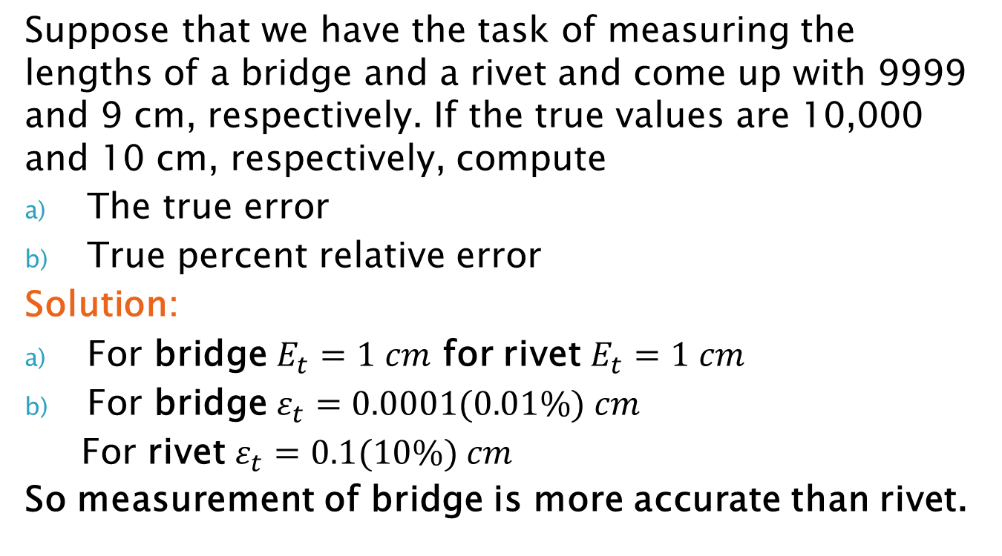
Error Definitions: Example
Suppose that we have the task of measuring the lengths of a bridge and a rivet and come up with 9999 and 9 cm, respectively. If the true values are 10,000 and 10 cm, respectively, compute
The true error
True percent relative error
Solution:
For bridge $E_{t}=1 cm$ for rivet $E_{t}=1 cm$
For bridge $ε_{t}=0.0001(0.01\%) cm$
For rivet $ε_{t}=0.1(10\%) cm$
So measurement of bridge is more accurate than rivet.

